Slide 1
Taskmanagment system
Presented by :
P.sushaalsai(bbpbv002)
g.Vamsi krishna(bbpbv010)
P.Arya teja(bbpbv004)
Ch.poorna sai tejA(BBPBV001)

Slide 2
TASK MANAGEMENT:Is It For Me?
How some people managed to be so organized!!!
Fed up managing works with repeated schedule??
Looking to increase your company’s productivity
Then
Task management is meant for
you………

Slide 3
It is a complete solution for
PROJECT PLANNING
DOCUMENT SHARING
OFFICE AND WORK MANAGEMENT
REMAINDERS&
ACCOUNTABILITY

Slide 4
Objectivies of task managment
An effective and efficient Task Management includes principle of “Gettings Things Done”.
Highly configured work flow
Can be deployed in house through Cloud
Design your own process and put control over them

Slide 5
Technologies Used:
Operating System:
Windows, Linux, or macOS
Java Development Kit (JDK):
JDK 8 or later for Spring Boot application development.
Integrated Development Environment (IDE):
Spring Tool Suite (STS), IntelliJ IDEA, or Eclipse with Spring Boot support for coding and development.
Database Management System (DBMS):
MySQL, PostgreSQL, Oracle, or another relational database system for storing task and user data.
Web Server:
Apache Tomcat or another compatible web server for deploying the Spring Boot application.
Version Control System:
Git for source code version control and collaboration.
Build Tool:
Apache Maven or Gradle for managing project dependencies and building the application.
Task Management System Framework:
Spring Boot framework for developing the Task Management System.

Slide 6
Frontend Technologies:
HTML, CSS, JavaScript, and a frontend framework (e.g., Angular, React, or Vue.js) for building user interfaces.
RESTful API Documentation:
Tools like Swagger or Postman for documenting and testing RESTful APIs.
Testing Frameworks:
JUnit, TestNG, or another testing framework for unit and integration testing.
Continuous Integration/Continuous Deployment (CI/CD) Tools:
Jenkins, Travis CI, or another CI/CD tool for automated testing and deployment.
Project Management and Issue Tracking:
Jira, Trello, Asana, or another project management tool for tracking tasks and issues.

Slide 7
Architecture:
The architecture of the Task Management System built with Spring Boot typically follows a layered architecture pattern, often referred to as a "three-tier architecture." Here's an overview of the architectural components:
Presentation Layer:
Contains RESTful controllers responsible for handling HTTP requests and responses.
Handles user authentication and authorization.
Communicates with the service layer to process user requests.
Service Layer:
Contains service classes that encapsulate business logic and application-specific functionality.
Orchestrates interactions with the data access layer (repositories) for CRUD operations.
Implements task management, user authentication, and other application services.
Data Access Layer:
Utilizes Spring Data JPA to interact with the database.
Defines entity classes that represent data objects (e.g., tasks, users).
Provides repositories for performing database operations.
Security Layer:
Enforces security measures, including authentication and authorization.
Implements role-based access control to protect resources.
Collaborates with the presentation and service layers to secure endpoints.

Slide 8
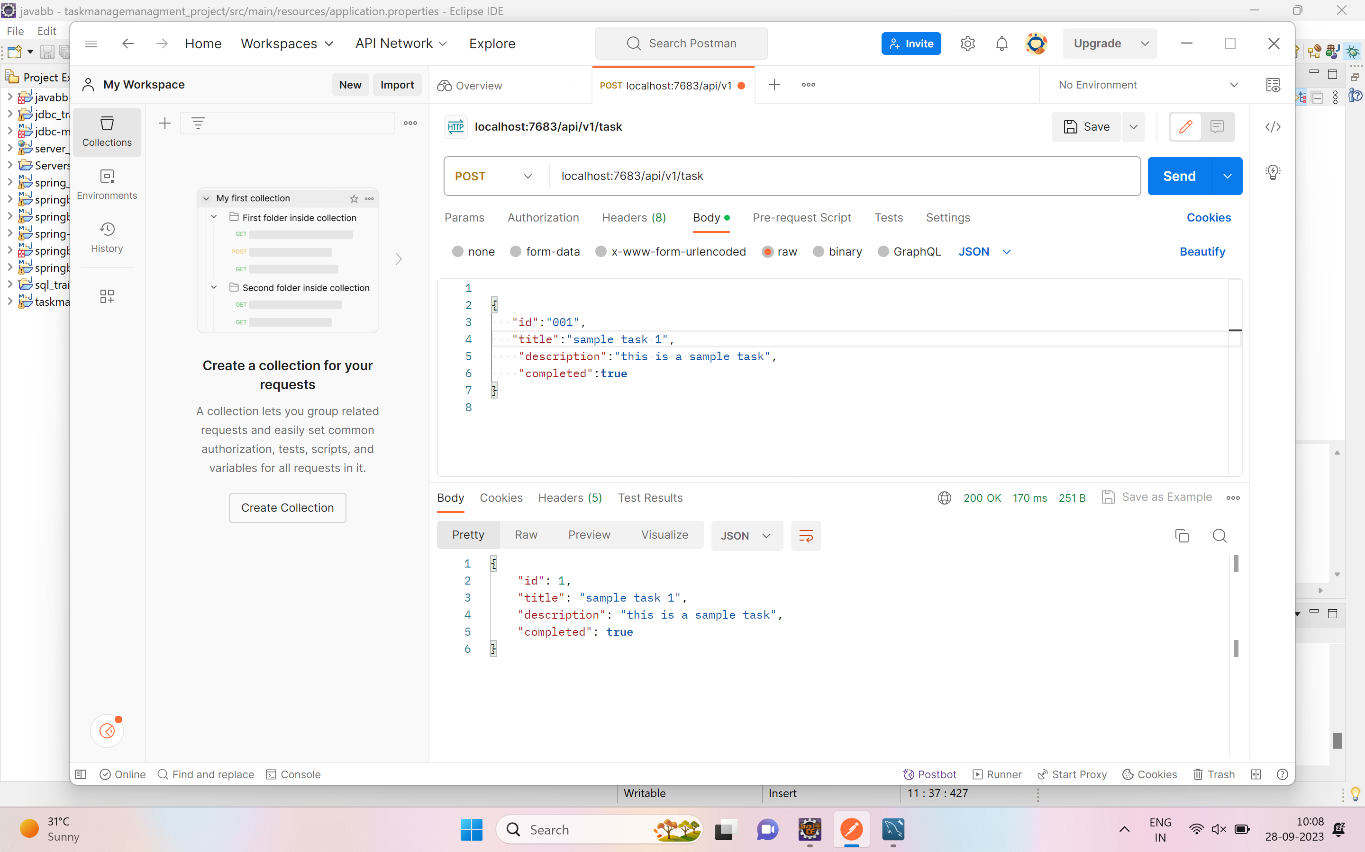
Insertion of data:
To insert the data into the data base we use the post method
By giving the api “localhost:7683/api/v1/task” we can insert the data into the database

Slide 9
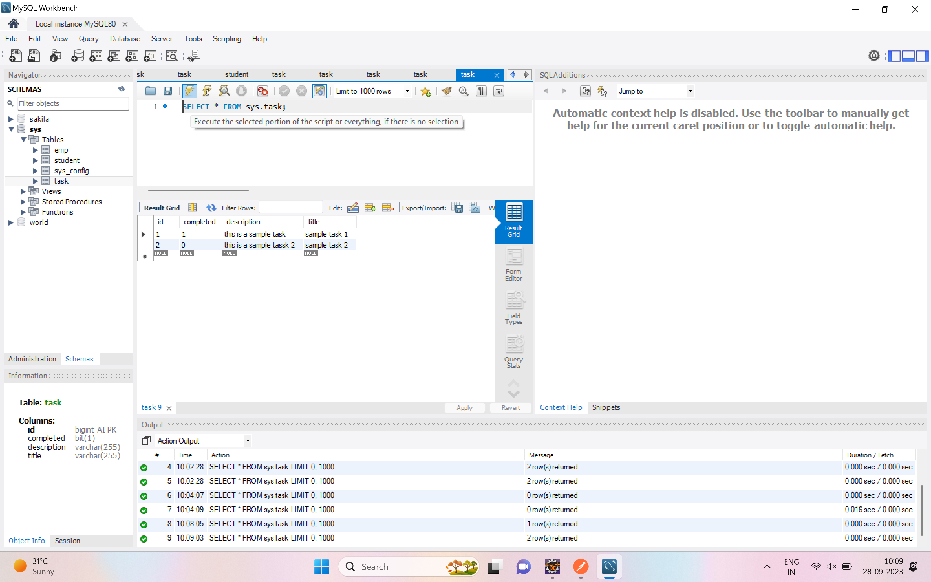
In the data base the table gets created by the hibnerate.
When ever we try to send the data from the postman the data gets inserted in the table

Slide 10
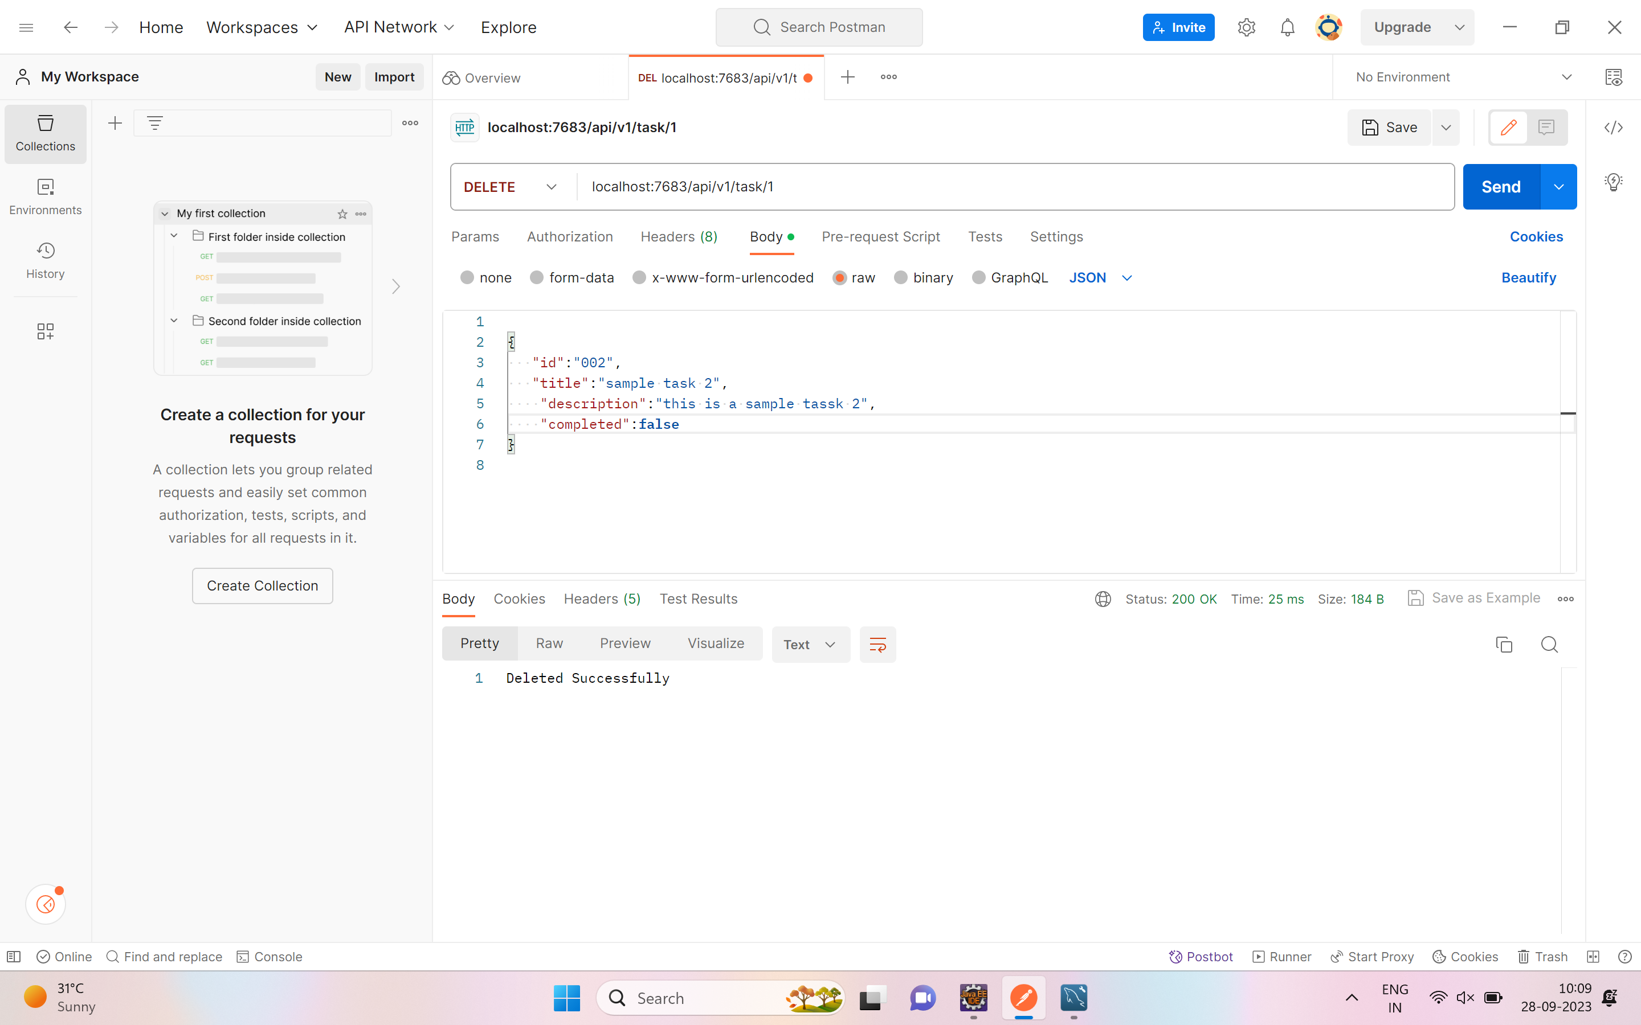
Deletion of Data:
To delete the data we use the delete mapping methd.
By giving the api “localhost:7863/api/v1/task/1”we can delete the task which has the id 1

Slide 11
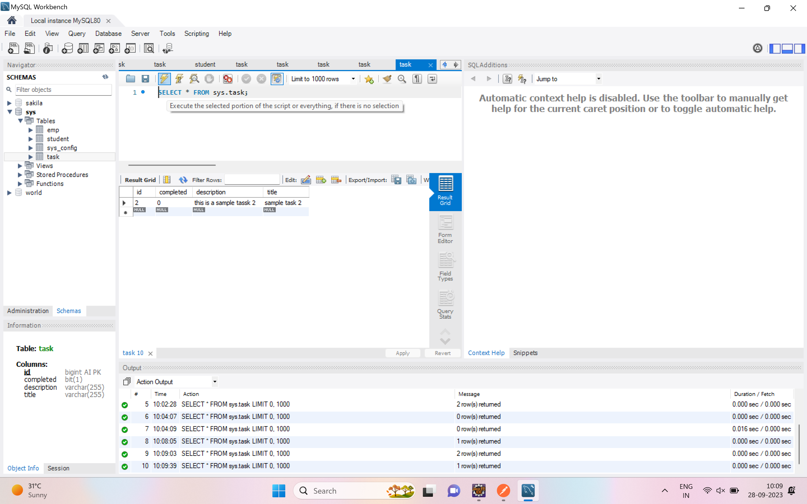
We can check the data base after sending the api in the post man
The record with th id 1 gets deleted.

Slide 12
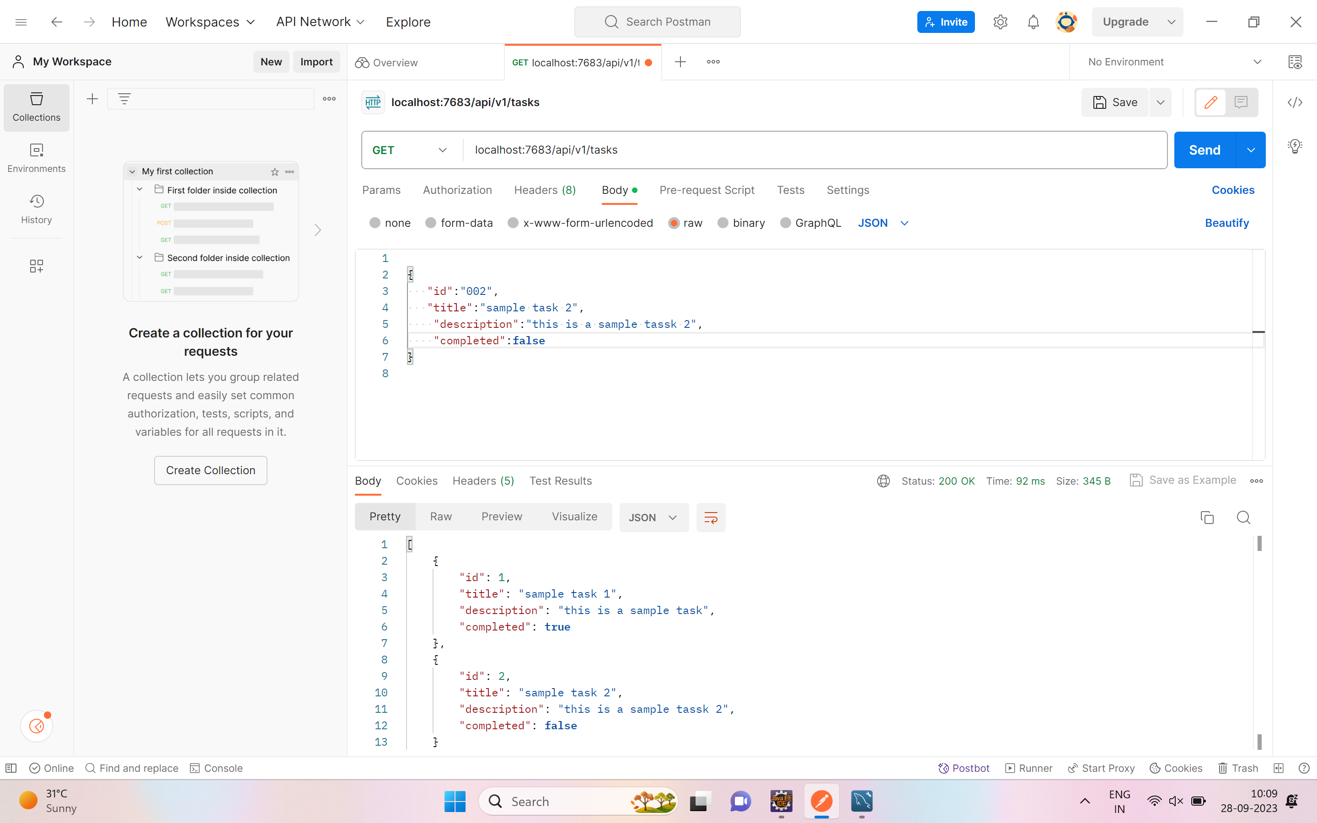
Getting all tasks:
To get the all tasks in the data base we use the get mapping method.
By giving the api “localhost:77863/api/v1/tasks”
We can get all the tasks in the database

Slide 13
Conclusion:
In conclusion, the Task Management System is a powerful and versatile tool designed to streamline and enhance task management within organizations. Throughout this documentation, we have explored the system's architecture, technology stack, database design, user interfaces, and a wide range of functionalities.
The system's architecture, built on the Spring Boot framework, ensures scalability, robustness, and flexibility. With its user-friendly interfaces, the system offers an intuitive experience for both administrators and end-users.
Users can efficiently create, assign, prioritize, and track tasks, facilitating improved collaboration and productivity. The notification system keeps all stakeholders informed, while reporting and analytics provide valuable insights into task management and team performance

